Slide 1
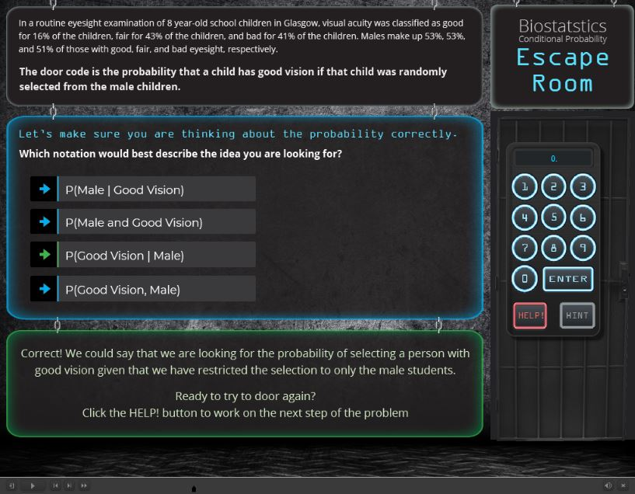
This typo appears every time this hint comes up

Slide 2
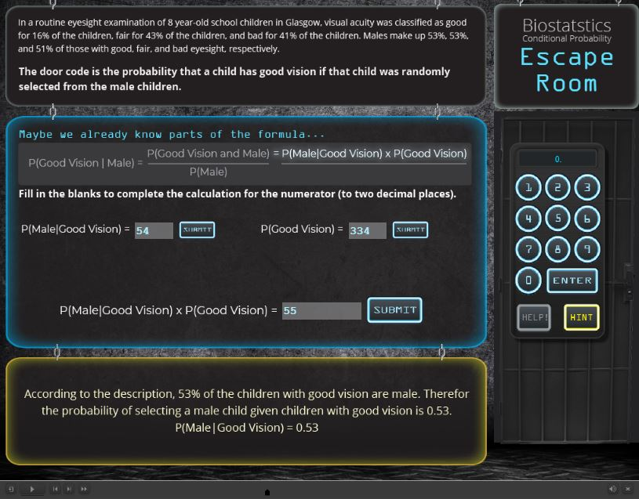

Slide 3
